Slide 1

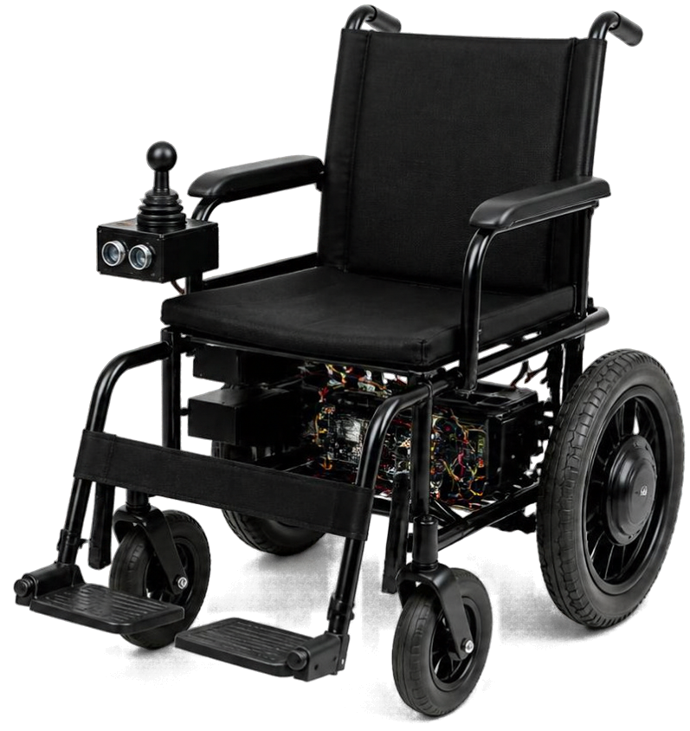
AI-Based Voice and Gesture Controlled Wheelchair
Smart mobility assistance
Gesture + voice control
ESP32 based prototype

Slide 2

Problem Statement
Paralysis can cause severe loss of muscle movement
Patients may have limited control of their hands and arms
Independent wheelchair movement can become difficult
Continuous physical control may not be possible
Patients may depend on caregivers for mobility

Slide 3











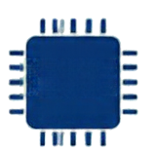






Proposed Solution
INPUT
PROCESSING
COMMUNICATION
CONTROLLER
Hand gestures control
wheelchair movement
Voice commands provide
an alternative input
ESP32
hand gestures
Python + MediaPipe
process gestures
python + mediapipe
bluetooth
commands sent to ESP32
Bluetooth sends commands to ESP32
voice commands

Slide 4
























System Architecture
User Input
AI Processing
Bluetooth
ESP32
L298N
Motors
Camera /
Microphone
Command
Generation
Wireless
Transmission
Microcontroller
Motor Driver
Wheel
Movement
MPU6050
Turning
Feedback

Slide 5

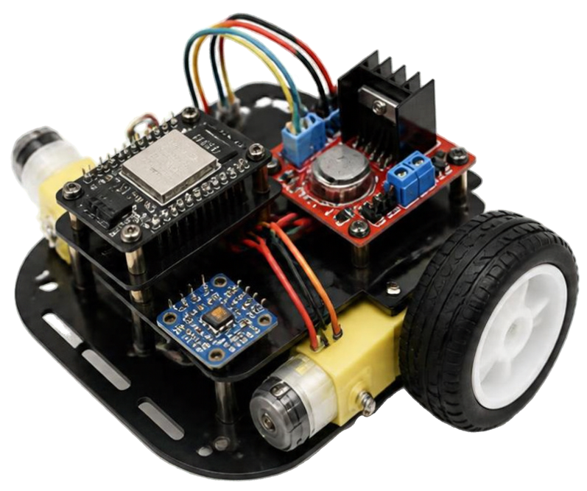











Motor &
Turning Control
ESP32 controls two DC geared motors
L298N drives the motors
Differential drive produces turns
MPU6050 measures Z-axis rotation
90° and 180° turns are supported

Slide 6


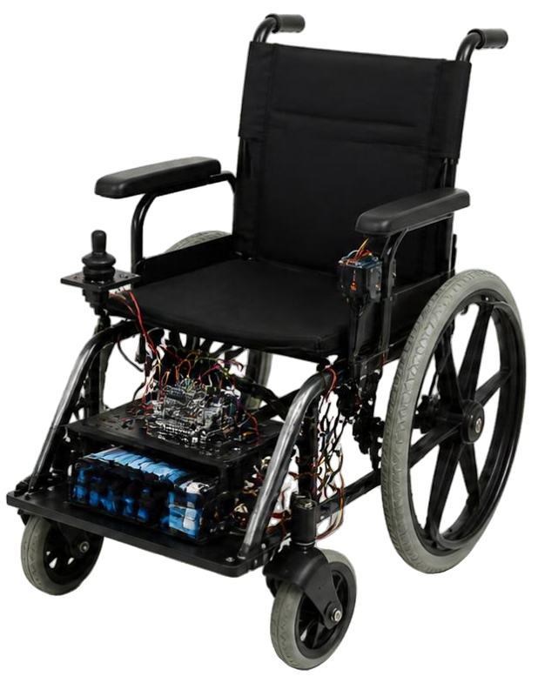










Working & Results
Hand captured
by camera
Hand landmarks detected with MediaPipe
Command sent
via Bluetooth
Hand gestures captured and recognized
Command received by ESP32
Commands sent wirelessly via Bluetooth
ESP32 processes the received command
Motors respond
to command
Motors respond to control the wheelchair
Prototype movement and turning achieved
Prototype movement and turning demonstrated

Slide 7






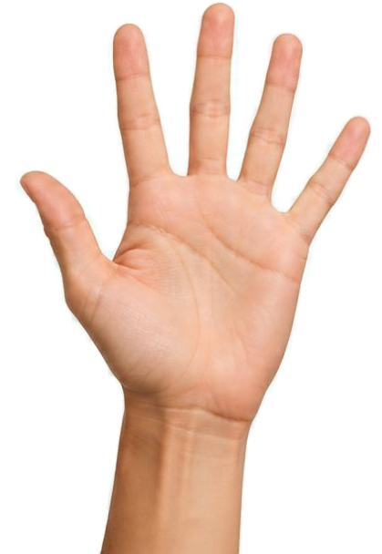




Gesture & Voice Control
Stop
Move Forward
Voice Commands
Forward
Turn Right
Backward
Left
Turn Left
Right
U-turn
Move Backward
Stop

Slide 8








Advantages & Future Scope
Contactless operation
Wireless communication
Obstacle detection and emergency braking
Two control modes
GPS tracking, caregiver monitoring and autonomous navigation
Simple and
low-cost prototype

Slide 9


Thank You
AI-Based Voice and Gesture
Controlled Wheelchair
Questions & Answers

